Slide 1
Please make a copy!
File -> Make a Copy
Remember to include your workbook and this presentation in your submission!

Slide 2
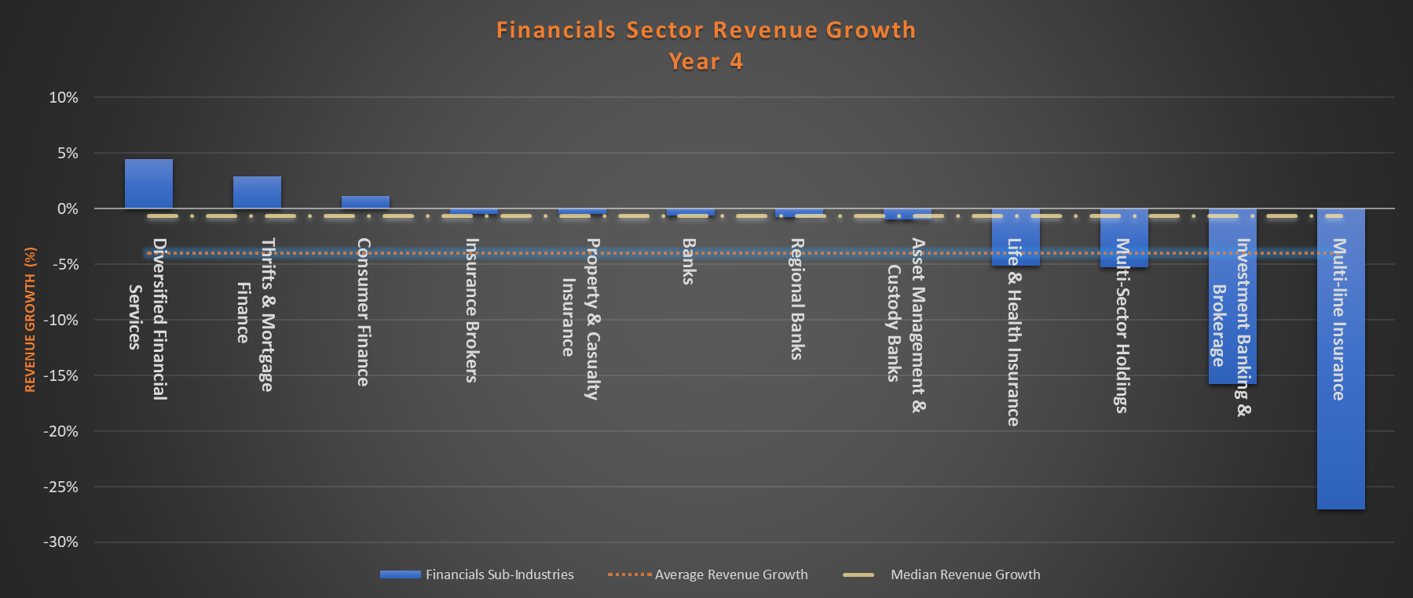
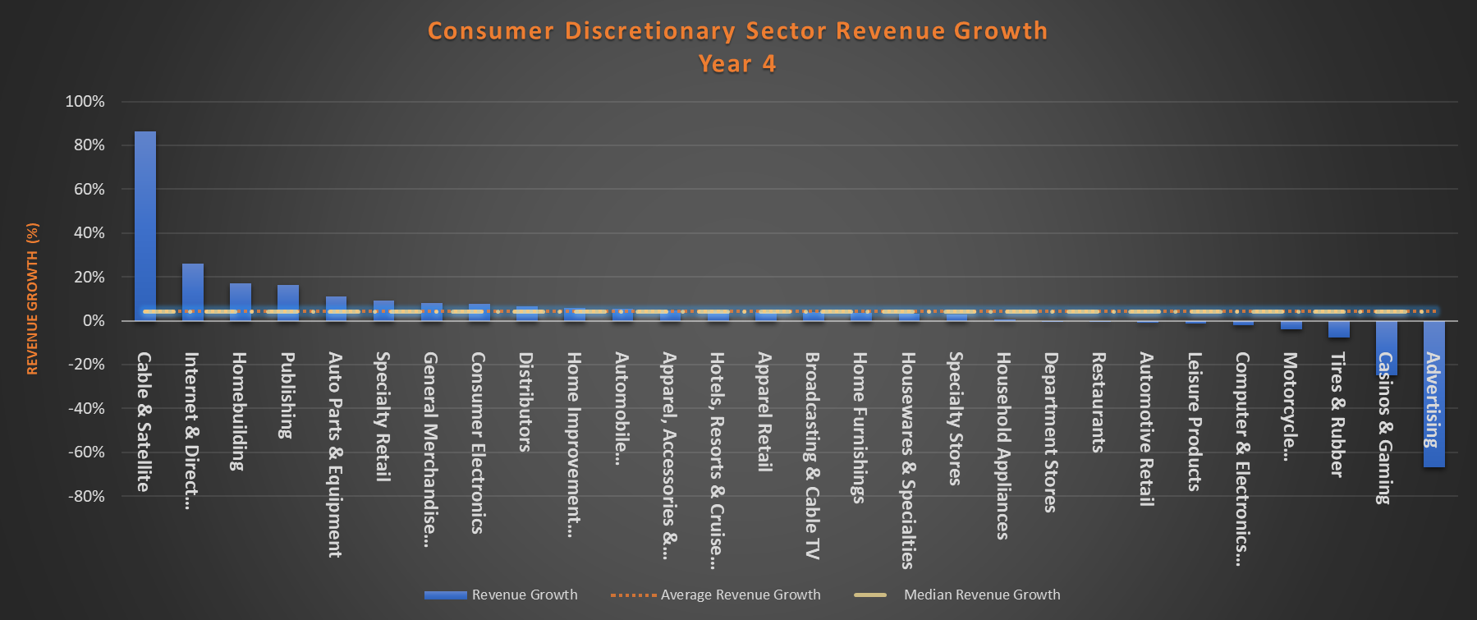
How did the revenue growth of the Financials Sector compare to the revenue growth of the Consumer Discretionary sector in Year 4?
Here are the column charts for the annual Revenue Growth for Financials and Consumer Discretionary sector companies reported in Year 4.
The Mean Revenue Growth for the Financials sector is about -4% which is 8 percentage points less than the Consumer Discretionary sector. Due to the deviation coming from the Multi-line Insurance sub-industry (-27%), the distribution is skewed. The median Revenue Growth has a slightly less disappointing outlook at -1%. The Standard Deviation in the Consumer Discretionary sector (at 22.69) is higher than in the Financials sector (at 8.92) indicating that the Consumer Discretionary sectors Revenue Growth values are more spread than that of the Financials sector. This also indicates that there is a higher variability in the Consumer Discretionary Sector. The same insight is indicated by the Range value of both sectors, whereas the Consumer Discretionary Sector has a range of 1.53 and the Financials sector has a range of .32.
Consumer Discretionary Sector had 4% in Revenue Growth. The Mean and Median are both the same at 4% indicating that the distribution is symmetrical. Leading the pack in growth is the Cable & Satellite sub-industry at 86%, which is 82 percentage points higher than the best performer in the Financials Sector (Diversified Financial Services at 4%). The Consumer Discretionary Sector has both the worst performer and best performer of the 2 sectors with the Cable & Satellite sub-industry at 86% and the Advertising sub-industry at -67%.

